Slide 1
Azure DevOps
Boards, Pipelines and Artifacts

Slide 2
What is DevOps?
Notes:
Get audience to pitch in.

Slide 3

Boards
Project Manager
Notes:
Kanban, boards, sprint management, backlog etc.

Slide 4

Repos
All your treasures
Notes:
Continuously build, test and deploy to any platform and cloud

Slide 5

Pipelines
Continuous Integration
Notes:
Continuously build, test and deploy to any platform and cloud

Slide 6

Test Plans
Fail early
Notes:
planned and exploratory testing services for your apps.

Slide 7

Artifacts
Packages
Notes:
Maven, npm, NuGet and Python package feeds
Like your own Nuget.

Slide 8
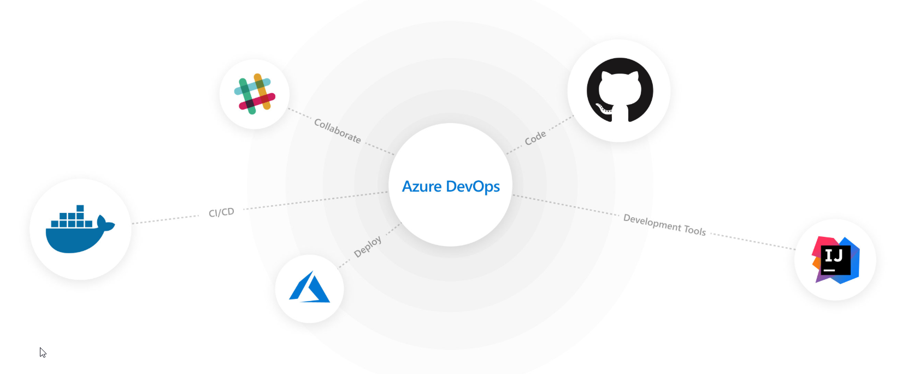
Integrations
Notes:
Mix and match the modular Azure DevOps tools to best fit your needs. Complement them with your existing tools and IDEs, and hundreds of integrations in the Marketplace.

Slide 9
YAML
YAML is a data serialisation language designed to be directly writable and readable by humans.
https://learnxinyminutes.com/docs/yaml/
Notes:
https://docs.microsoft.com/en-us/azure/devops/pipelines/yaml-schema?view=azure-devops&tabs=schema

